Slide 1
BLOOD BANK MANAGEMENT SYSTEM
by-
M.GANESH-2010030420
A.KARTHIKEYA-2010030442
VAIBHAV VENKATESWARAN-2010030357
P.VENKATA KISHORE-2010030569

Slide 2
TABLE OF CONTENTS
INTRODUCTION
LITERATURE SURVEY
EXISTING SYSTEM
PROPOSED SYSTEM
GITHUB
SOFTWARE AND HARDWARE REQUIREMENTS
CONCLUSION

Slide 3
INTRODUCTION
Our project Blood Bank system using a Web application is developed so that users can view the information of nearby hospitals, blood banks and volunteer donors.
This project is developed by three perspectives i.e., blood bank, volunteer donors and patient.
Thus, this application provides the required information in less time and helps in quicker decision making.
The main aim of this project is to save lives of people by providing blood.

Slide 4
EXISTING SYSTEM & PROPOSED SYSTEM
EXISTING SYSTEM
PROPOSED SYSTEM
The operation of the blood bank still now is maintained in the manual system.
It creates room for errors as the data is entered manually by the persons.
The operation is tedious and time consuming.
We proposed a system Blood Bank Management System is designed to save the life of people who required blood in time by sending and/or serving the request for Blood as and when required.
The proposed system gives the procedural approach of how to bridge the gap between hospitals, Donor, and Blood Banks.
Goals
To ease the process of blood donation .
To improve the existing system.
To develop a scalable system.

Slide 5
LITERATURE SURVEY
S no | Author | Year | Problems discussed and Solved | Result
1 | 2Teena, C.A, Sankar, K. and Kannan | 2014 | A Study on Blood Bank Management | Their system allowed an authorized blood bank administrator to sign in with a password to manage easily the records of donors and patients who need blood. The system provided many features including the central database, quick access to the system content through the login, includes the search code to find donors on a given basis, and the ease of adding and updating donor data.
2 | Kumar.R, Singh, S. and Ragavi | 2017 | Blood Bank Management System. | The researchers developed a web-based blood management which assists the blood donor records management and provides ease of control in the distribution of blood products in various parts of the country considering demands of hospitals.
3 | Liyana | 2020 | Blood Bank Management System Using Rule-Based Method | The author developed a web-based system to help the blood bank to record the donor details fast and easy. The system used rule-based decisions to ensure to have a right decision on right time. Also, system can send messages to donors if any particular blood type is needed.

Slide 6
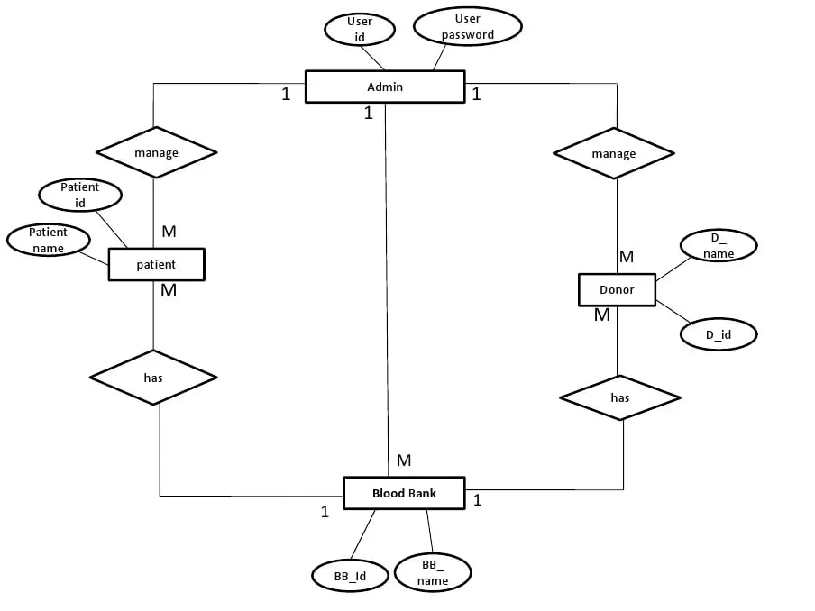
Modules
Admin
Patient
Donor
Blood Bank

Slide 7
SOFTWARE & HARDWARE REQUIREMENTS
SOFTWARE REQUIREMENTS
HARDWARE REQUIREMENTS
Operating system : Windows 11.
Coding Language : JAVA
Frontend: HTML
Backend: MySQL
Server: Apache Tomcat 9
IDE : Eclipse
Hard Disk : 1 TB.
Monitor : 15’’ LED
Input Devices : Keyboard, Mouse
Ram : 8 GB
Processor: 1GHz or High

Slide 8
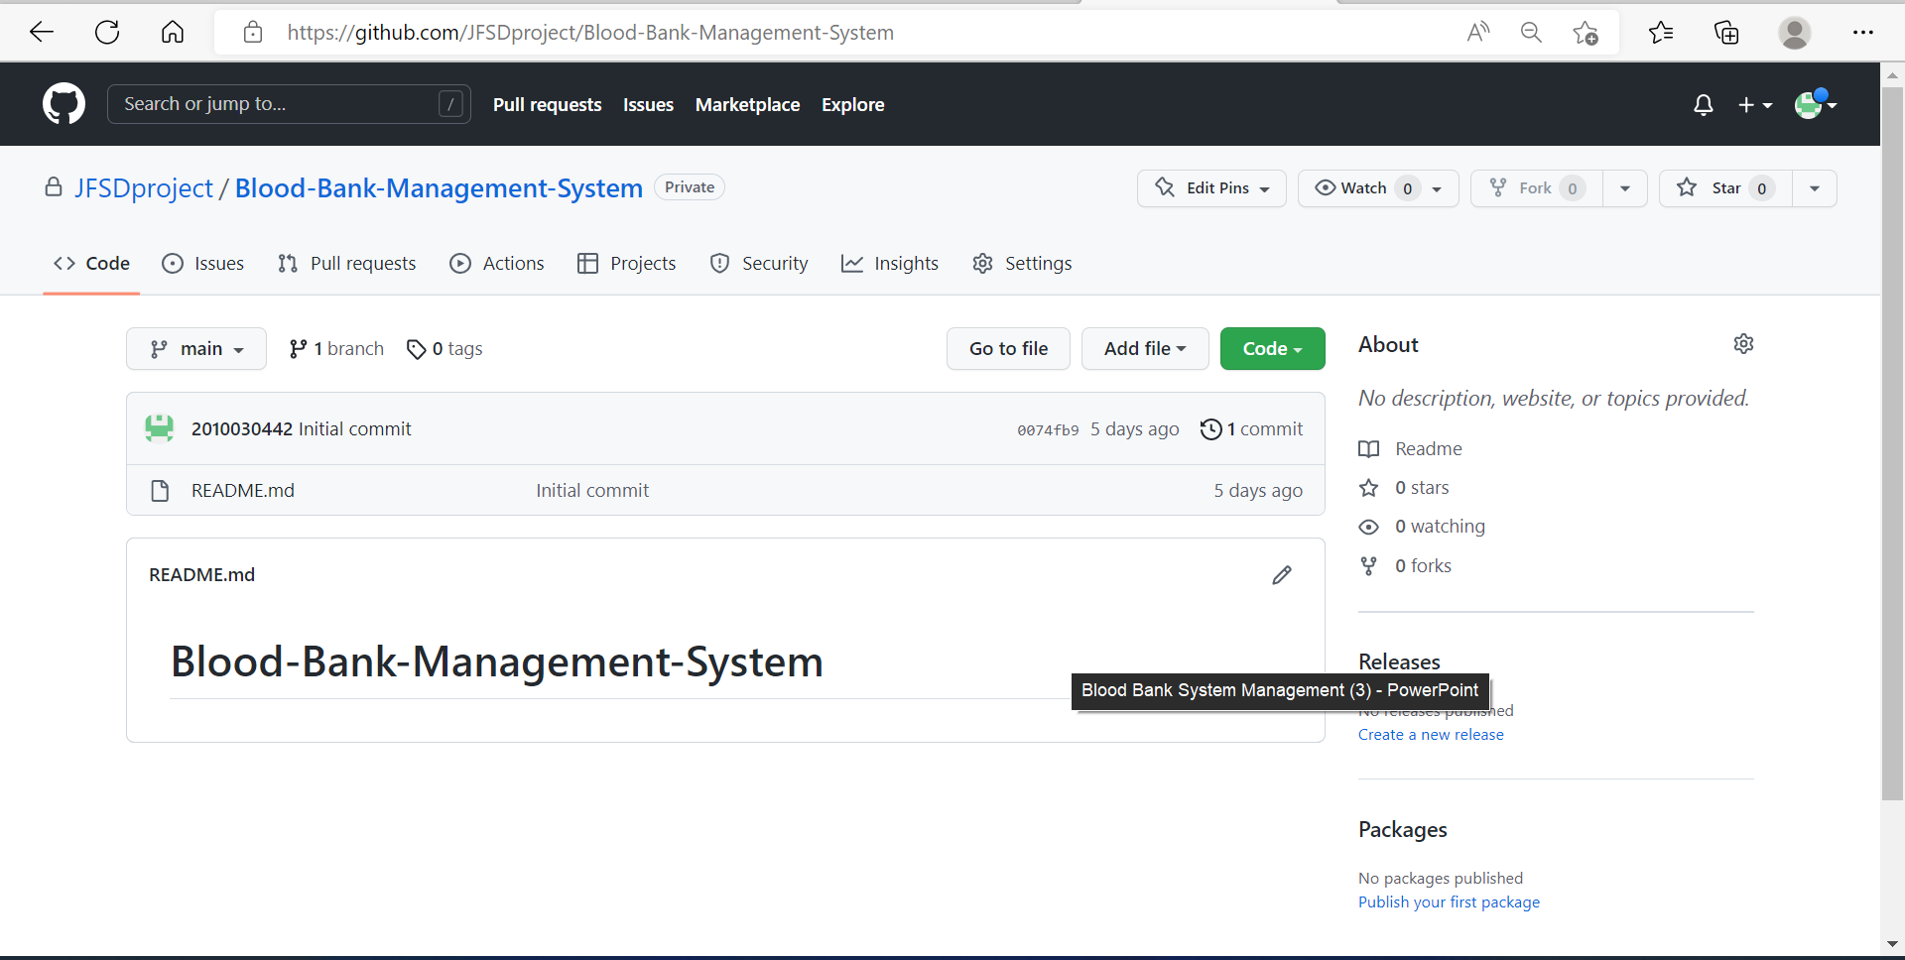
GITHUB

Slide 9
CONCLUSION
This proposed Blood Bank Management System gives a reliable platform for both donors and acceptors.
The Blood Bank Management System is a web-based application that helps to minimize human errors and problems pertaining to data redundancy.
It is a fast-paced and efficient way to communicate without any security threats as the data entered will be verified and frequently updated thereby increasing the probability of saving one's life. Moreover, the availability of a location-based system where the nearest blood bank can be located through Google maps makes it more accessible.

